Slide 1
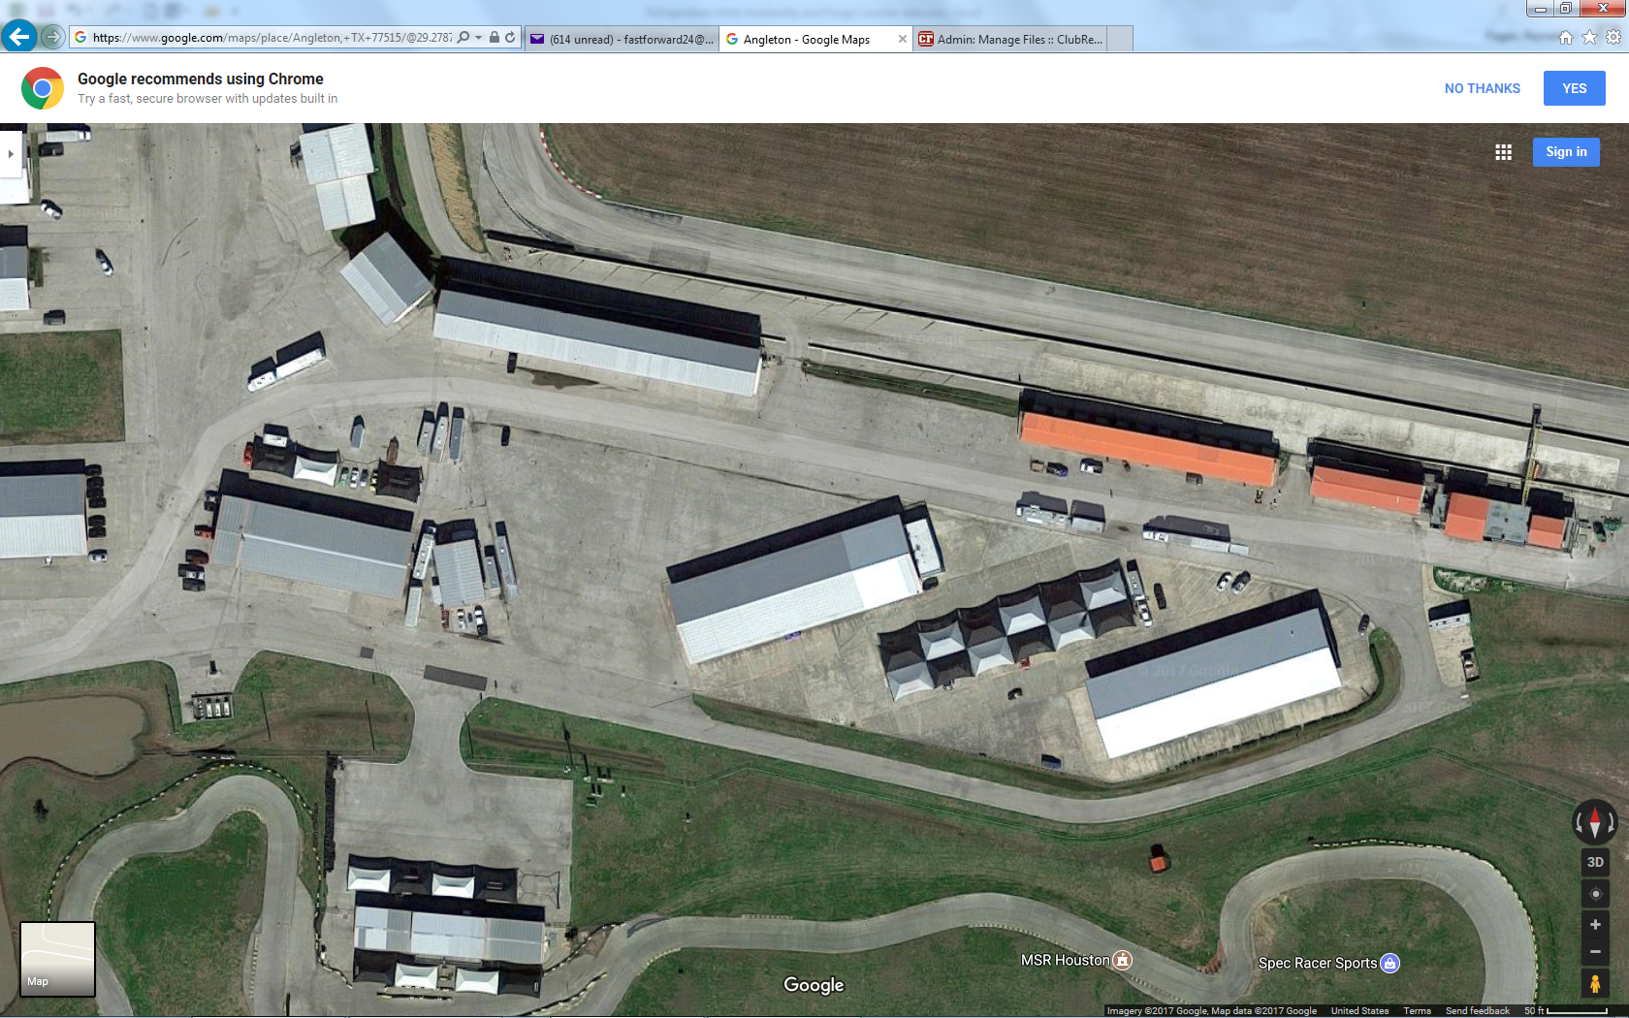
MSR-Houston CW Layout
Trailer and track parking
Track entrance
Grid
Track cars parking (green areas)
Control Tower
Track exit to paddock
Awnings
Instructors
Entrance/Exit
1 → 24
Break Room Classroom
Gas
Pumps
Bathrooms
MSR Karting

